Slide 1
Enhanced Multi-Sequence Learning with Improved Accuracy
Presented by: Starwars Group
Syeda Ayesha Asad
Muhammad Zubair
Syed Tabish Talha Hassan

Slide 2
TABLE OF CONTENT
Problem Statement
Introduction to Multi-Sequence Learning, Scalar Encoders and HTM
Methodology
Implementation
Flow chart for Enhance Multi Sequence Learning
Results
Conclusion
References

Slide 3
Problem Statement
Multisequence Learning is a powerful approach for understanding and predicting sequences, such as musical notes or genetic patterns, with applications across various industries. While existing implementations like MultisequenceLearning.cs offer effective learning and prediction capabilities, there's a need to enhance the process.
Our task is to develop a new method, TrainModel, to automatically read sequences from a file and train the model. Since sequences lack semantic connections, implementing a loss function for cross-entropy calculation is not feasible. After training, the model must be evaluated using subsequences from a testing file.
Additionally, generate a testing file with unseen sequences similar to those learned. Ultimately, the code should autonomously load sequence files, train the model, and output accuracy, ensuring robustness across different training datasets.

Slide 4
Introduction to Multi-Sequence Learning & HTM
Multi-Sequence Learning:
Understand and predict patterns across multiple sequences of data.
Applicable in finance, healthcare, and natural language processing.
Hierarchical Temporal Memory (HTM):
Inspired by the human neocortex's structure and function.
Specializes in learning temporal patterns in streaming data.
Ideal for multisequence learning tasks requiring temporal context analysis.

Slide 5
Introduction to Scalar Encoders and HTM Prediction Engine
Scalar Encoders:
Convert single-valued data into sparse distributed representations (SDRs).
SDRs preserve similarity between scalar values, enabling pattern recognition.
HTM Prediction Engine:
Analyze time-series data by learning temporal patterns.
Adapt to changing data distributions for accurate predictions.
Generate predictions about future states or events based on learned patterns.

Slide 6
Methodology
Analysis of Existing Implementation:
Evaluate the current multi-sequence learning framework based on Numenta's HTM model.
Identification of Enhancement Areas:
Identify opportunities to enhance accuracy and capabilities.
Development of Sequence Generator:
Create a sequence generator capable of generating random datasets for alphabetic and numeric sequences based on user-defined parameters.
Transformation for Alphabetic Sequences:
Devise a method using ASCII encodings to transform alphabetic sequences for compatibility with the HTM model.

Slide 7
Methodology
Integration with HTM Model:
Integrate transformed alphabetic sequences and numeric datasets into the HTM model for learning and prediction tasks.
Evaluation and Testing:
Create supplementary datasets for evaluation and testing to assess accuracy and performance.
Iterative Improvement:
Continuously evaluate model performance and make iterative enhancements based on results.

Slide 8
Implementation
Framework Enhancement:
Significantly improved the multi-sequence learning accuracy.
Expanded capabilities to handle both numeric and alphabetic datasets effectively.
Introduce threads to learn multiple training data simultaneously.
Sequence Dataset Generation:
Developed a sequence generator to create random datasets for alphabetic and numeric sequences.
User-defined parameters such as the number of sequences and value range facilitate dataset generation.
Two additional datasets are generated for evaluation and testing purposes, crucial for accuracy assessment
Taking user input for dataset generation
Generating (Alphabet/Number) Dataset
Saving the dataset into a file
Loading the saved Dataset in program
Transforming the sequence (if alphabet the change into ASCII) and feeding it to the model
Figure.1: Generating and preparing dataset.

Slide 9
Implementation
Passing the Dataset(Alphabet/Number)
Numeric and Alphabetic Dataset Learning:
Alphabetic sequences require transformation to ensure compatibility with the HTM model.
Utilized ASCII encodings to convert alphabetic sequences into their respective representations.
Transformed sequences are integrated into the HTM model for seamless learning and prediction processes.
Evaluation and Testing:
Evaluation and test datasets derived from primary datasets are essential tools for accuracy assessment.
Randomly selected sub sequences from primary datasets facilitate thorough evaluation and performance analysis.
Encoding the data using scalar encoder
Stabilizing the spatial pooler for each input through several iterations
Recognizing Temporal sequence within data
Making a Prediction
Figure.2: Dataset Learning process.

Slide 10
Flow chart for Enhance Multi Sequence Learning Experiment:
Start.
MSL –Number
MSL -Alphabet.
Dataset Generation: Number
User Input.
Dataset Generation: Alphabets
Data Transformation into ASCII
Training of Number/Alphabet sequence
Prediction
End
Figure.3: Flow chart for Enhance Multi Sequence Learning Experiment.

Slide 11
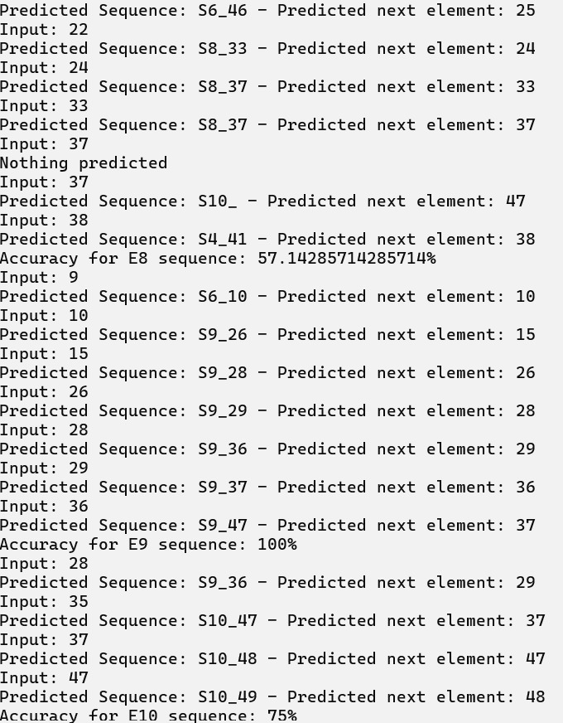
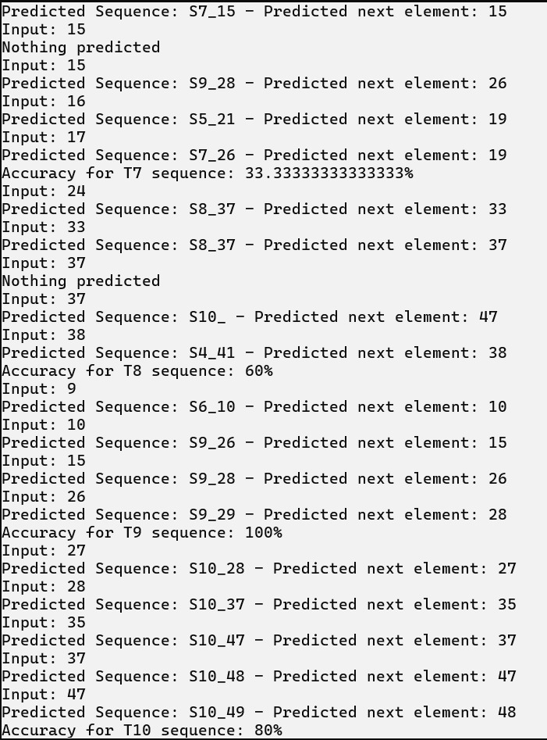
Results
-Multi Sequence Learning – Sequence of Numbers:
Figure 4 and figure 5 below illustrate the model in the process of predicting sequences within the evaluation and test datasets. Following training, the model demonstrates the ability to predict each sequence with an accuracy ranging from 35% to 100%, averaging at 53%. This marks a significant improvement compared to the previous implementation, where the test accuracy for number datasets was below 25%.
Figure.4: Accuracy of evaluation dataset– Sequence of Numbers
Figure.5: Accuracy of test dataset– Sequence of Numbers

Slide 12
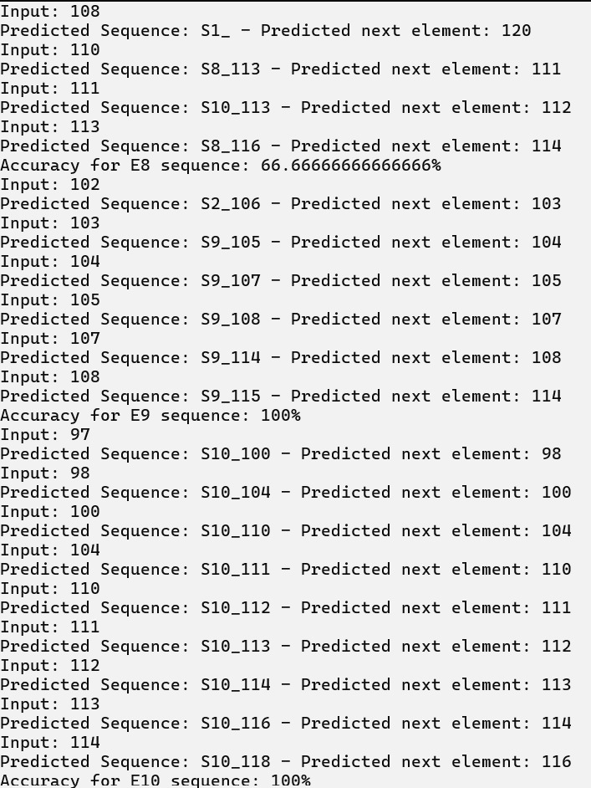
Results
-Multi Sequence Learning – Sequence of Alphabets
Figure 6 and figure 7 below illustrate the model in the process of predicting sequences within the evaluation and test datasets. Following training, the model demonstrates the ability to predict each sequence with an accuracy ranging from 35% to 100%, averaging at 53%. This marks a significant improvement compared to the previous implementation, where the test accuracy for number datasets was below 25%.
Figure.6: Accuracy of evaluation dataset– Sequence of Alphabets
Figure.7: Accuracy of test dataset– Sequence of Alphabets

Slide 13
Conclusion
Our project significantly advances multi-sequence learning by enhancing the Hierarchical Temporal Memory (HTM) framework. We developed a versatile dataset generator and implemented concurrent processing for efficient evaluation. Through fine-tuning parameters, we improved accuracy, achieving precise predictions across numeric and alphabetic datasets. Leveraging HTM principles and sparse distributed representations, our model captures complex temporal patterns effectively. Our work highlights the potential of HTM-based approaches in sequence learning and underscores the importance of comprehensive dataset generation and rigorous evaluation strategies. This project lays a solid foundation for further advancements in artificial intelligence and sequence learning methodologies.

Slide 14
References
“Sparse Distributed Representations Sparse Distributed Representations,”2016. Available: https://www.numenta.com/assets/pdf/biological-and-machine-intelligence/BaMI-SDR.pdf
Y. Cui, S. Ahmad, and J. Hawkins, “The HTM Spatial Pooler—A Neocortical Algorithm for Online Sparse Distributed Coding,” Frontiers in Computational Neuroscience, vol. 11, Nov. 2017, doi:
https://doi.org/10.3389/fncom.2017.00111.
Kjell Jørgen Hole, “The HTM Learning Algorithm,” Springer eBooks, pp. 113–124, Jan. 2016, doi:
https://doi.org/10.1007/978-3-319-30070-2_11.
S. Purdy, “Encoding Data for HTM Systems.,” arXiv (Cornell University), Feb. 2016.

